Slide 1
Why Does My Computer Do That? Intro to Coding with Python– Random Module
Dr. Ab Mosca (they/them)
Slides based off slides courtesy of Jordan Crouser (https://jcrouser.github.io/)

Slide 2
Plan for Tuesday
Next Tuesday, 10/10, is a Monday schedule
I will have office hours in this room during class time (9:20 – 11:15) for anyone who has hw or general questions, or wants to touch base

Slide 3
Plan for Today
What is random?
The random module

Slide 4
Discussion
What does it mean
for something to be random?

Slide 5
Expectation #1: even distribution

Slide 6
Expectation #1: even distribution
Every value has an equal chance of being chosen
Example: if we roll a die several times, we expect to see:
1 roughly 1/6 of the time
2 roughly 1/6 of the time
3 roughly 1/6 of the time, etc.
On average (over a large number of samples) the distribution is roughly uniform

Slide 7
Discussion
Is an even distribution enough?

Slide 8
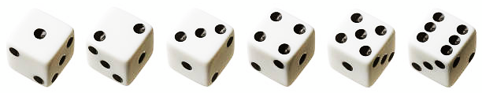
What if the die always rolled like this?

Slide 9

Expectation #2: unpredictable

Slide 10
Expectation #2: unpredictable
Randomness is more than ensuring that every value has an equal chance of being chosen
We also want each value to be hard to predict
Specifically: seeing several values in the series (“rolls”) shouldn’t help us guess the next one

Slide 11
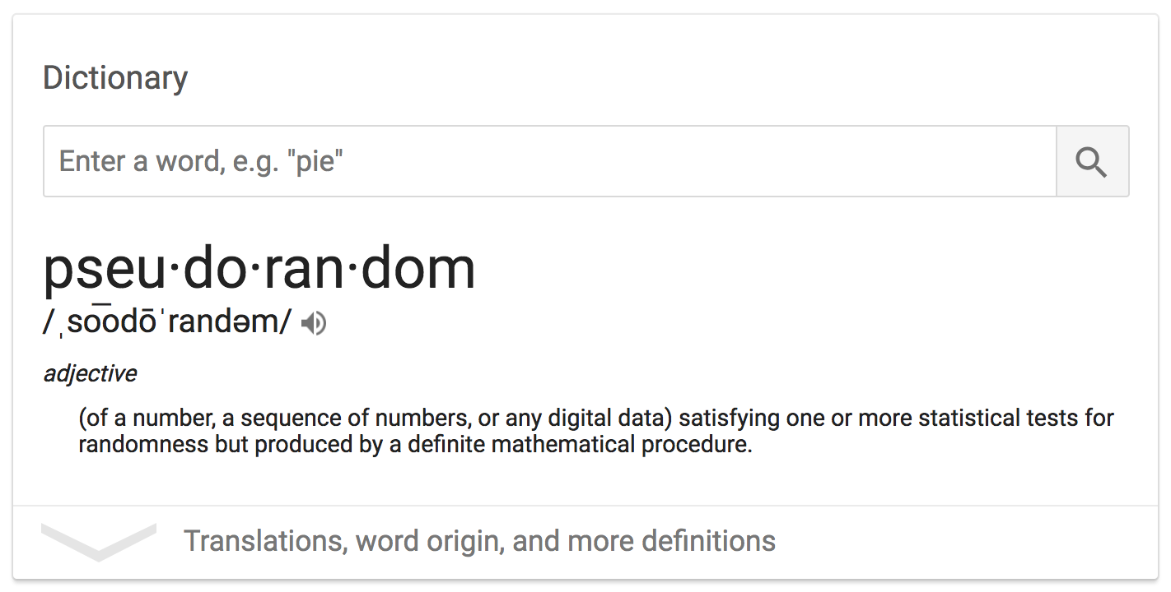
Pseudorandom numbers

Slide 12
Pseudorandom numbers
“random number
generator” (RNG)

Slide 13
Pseudorandom numbers
“random enough"
“random number
generator” (RNG)

Slide 14
Discussion
How could a deterministic machine
generate a (seemingly) random value?

Slide 15
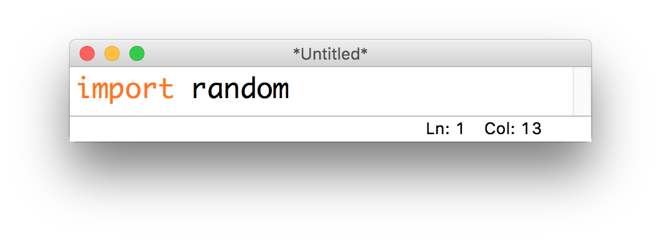
The random module
Python’s built-in RNG can be accessed through the random module
This module contains several useful functions, all of which are documented here:
https://docs.python.org/3/library/random.html

Slide 16
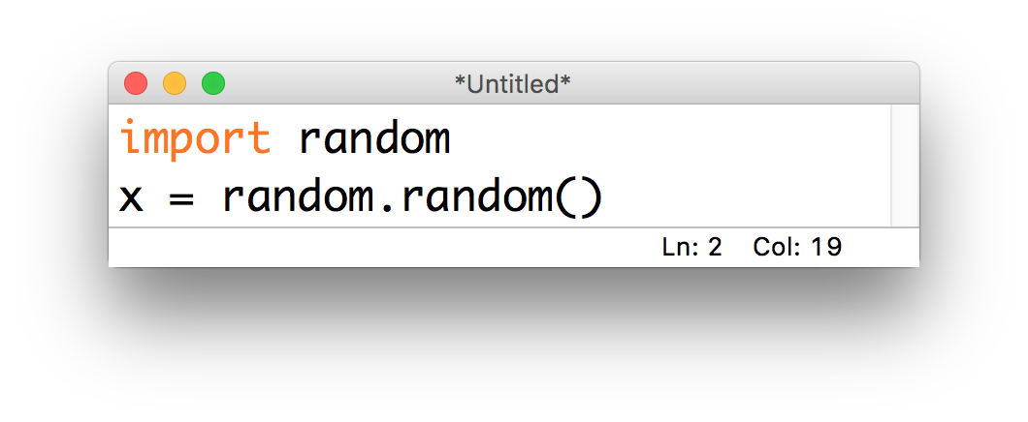
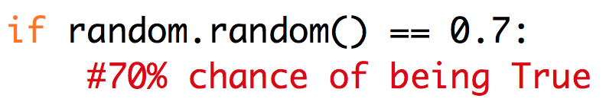
Generating a random float
The simplest way to get a random number is by calling the .random() function:
This always returns a float with a value in [0.0, 1)
Particularly useful for setting probabilities:

Slide 17
10-minute exercise: coin flip
Use the .random() function from the random module
to write a program that prints HEADS 50% of the time
and TAILS the remaining 50% of the time

Slide 18
Discussion
What if we wanted a random float
in a different range?

Slide 19
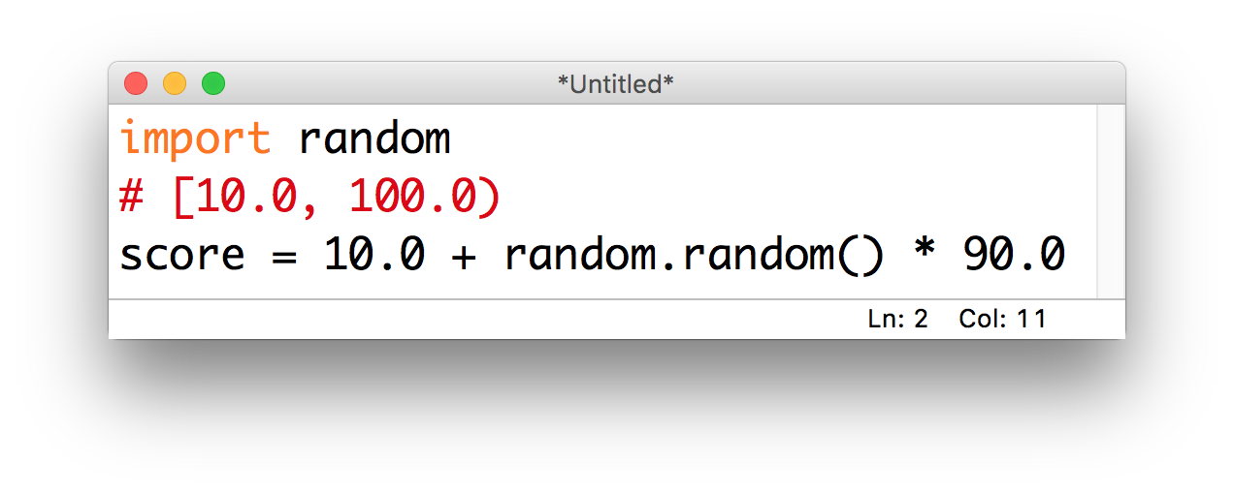
random floats in other ranges
Just use math!
Example: imagine a homework assignment is scored out of 100 points (partial points allowed, and you get 10 points for writing your name)

Slide 20
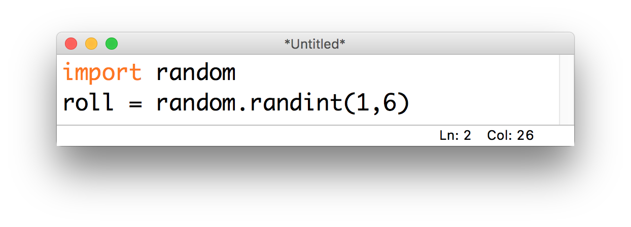
Generating a random integer
We could multiply, add and call int(...) to get a random integer using .random(), but there’s no need!
The .randint(...) function takes two arguments min and max, returns an integer in [min, max] (inclusive):

Slide 21
Discussion
How could we use this to choose a random item from a list?

Slide 22
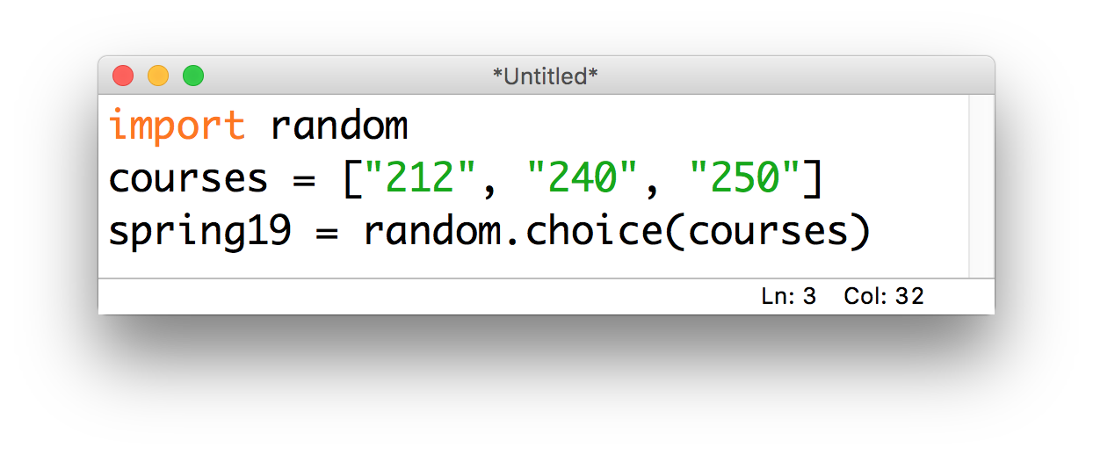
Choosing a random item
Unsurprisingly, other people have also noticed that this would be a useful feature… so there’s a function for that!
The .choice(...) function takes in a list, and returns a randomly selected element:

Slide 23
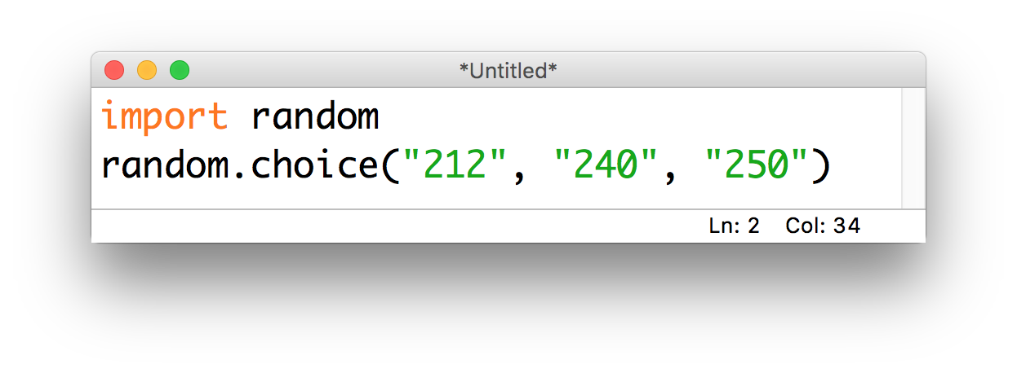
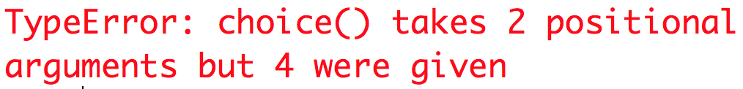
A common gotcha
The .choice(...) function only works when given a list-like object:
Don’t forget the brackets!

Slide 24
Discussion
What happens if we
call .choice(...) on a string?

Slide 25
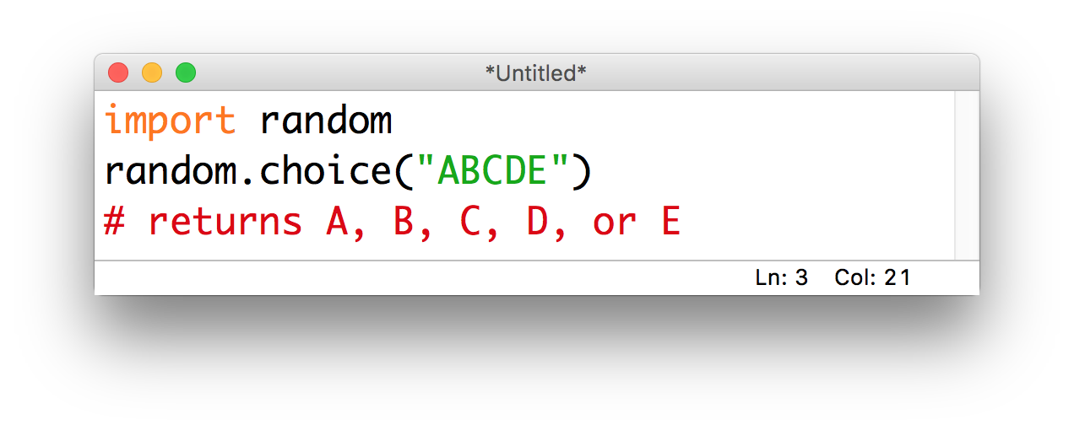
.choice(...) on strings
Strings are list-like!
The “items” in a string are the individual characters, so this is what .choice(...) chooses between:

Slide 26
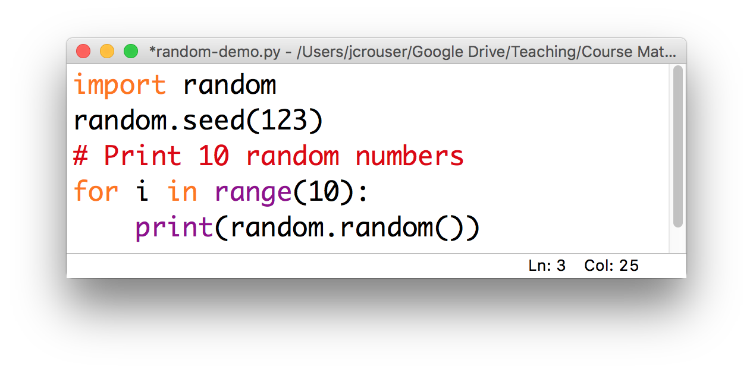
A note on testing random programs
It can be really challenging to test a program that behaves differently every time you run it
In order to solve this, we can tell python precisely how to generate its (not-so-random-anymore) random numbers using a parameter called a seed

Slide 27
A note on testing random programs
It can be really challenging to test a program that behaves differently every time you run it
In order to solve this, we can tell python precisely how to generate its (not-so-random-anymore) random numbers using a parameter called a seed

Slide 28
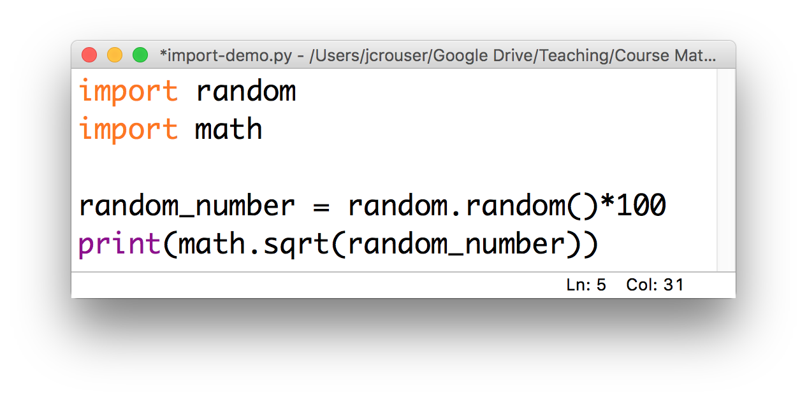
A note on importing modules
So far, we’ve always imported modules like this:

Slide 29
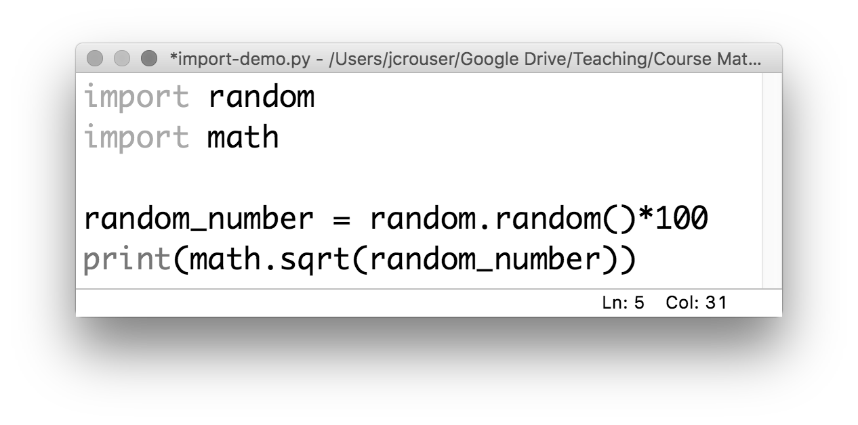
A note on importing modules
To use a function, we need to specify the module:
This prevents “name clashes” (i.e. if two functions have the same name, the second one overwrites the first)

Slide 30
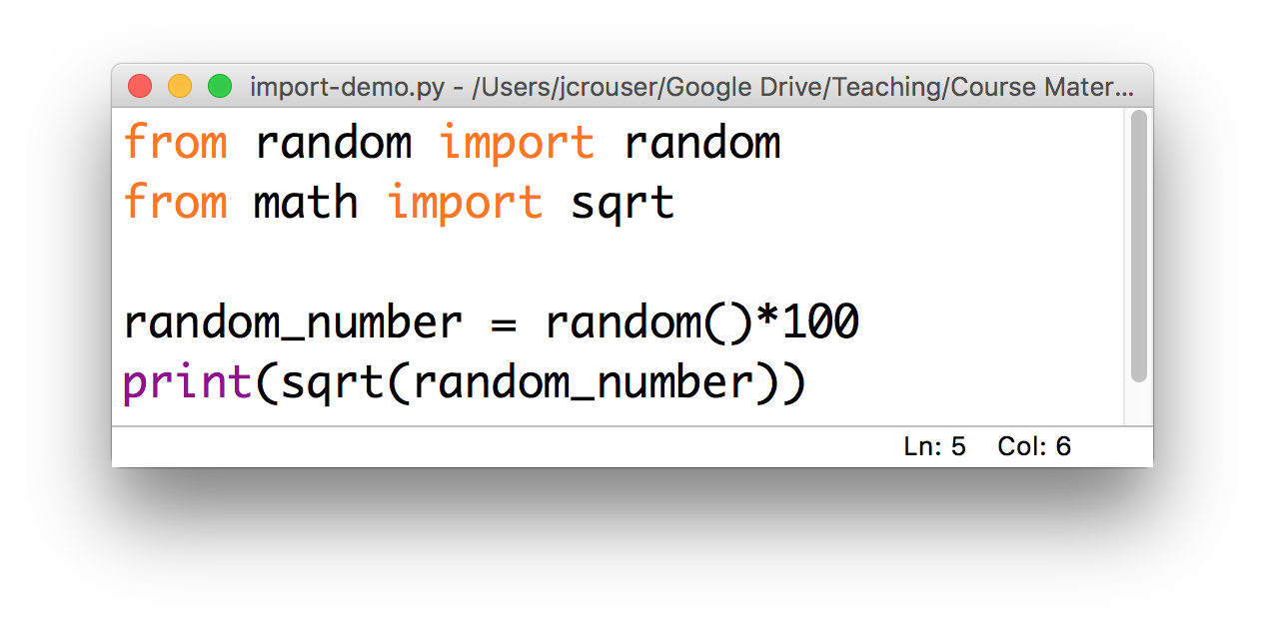
A note on importing modules
However, there’s also another way:
This is useful if we only need specific functions and we want to save ourselves some typing

Slide 31
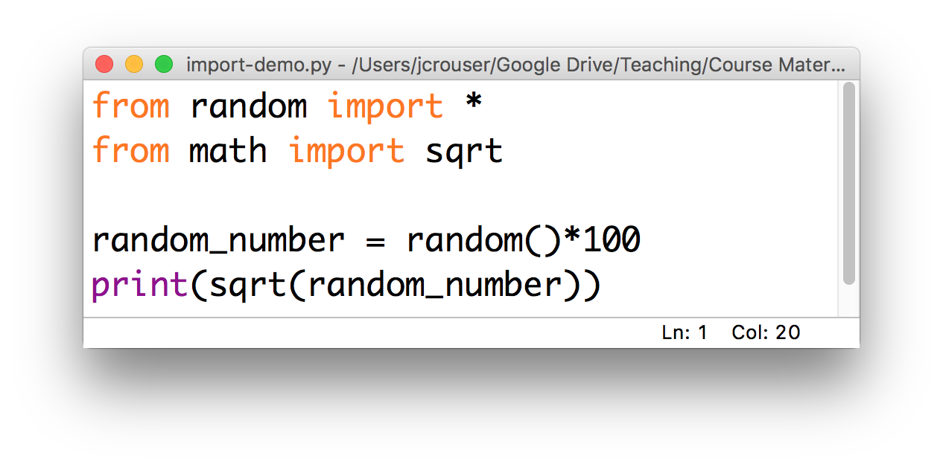
A note on importing modules
We can use * to import everything from a module :
Again, just be cautious of name clashes…

